Slide 1

Understanding the Implication of Online Education in US
Maharishi University of Management
Business Intelligence & Data Mining

Slide 2






Team Members:
Hardi Chandra
hardi.chandra.hc@gmail.com
Bharat Kurma
bkurma30s@gmail.com
Joy Kareen Landicho
landichojkd@yahoo.com
Manish Kaur
myfriend999@rediffmail.com
Zeina Rawashdeh
zeina.moneeb@gmail.com
Robera Aberra
ekiboy468@yahoo.com

Slide 3
Overview
Wholeness of the Project
Literature Review
Research Hypothesis
Data & Research Methodology
Findings/Interpretation
Conclusion
Limitations & Options for Future Research
Relationship with SCI

Slide 4
Wholeness of the Project
Part I

Slide 5
Why we choose Online Education?
The eLearning Revolution
This is the single biggest change in education since the invention of printing press.
We are eager to know how big Online Education can be in the future.
This might change the world dynamics.

Slide 6
Research Questions:
1. Does the continuous growth of Online Education has any impact on:
Traditional face-to-face Education
Since online education is growing very fast, will this growth have any impact for the traditional education?
Will it overtake or even replace the traditional face-to-face education in the near future?
#trending

Slide 7
Research Questions:
2. Does the continuous growth of Online Education has any impact to:
Economic Development
Because of the flexibility offered by online learning, people are able to get more educational attainability to meet business need and learning demands.
Will it help the economy to grow faster?
#flexible

Slide 8
Research Questions:
3. Does the continuous growth of Online Education has any impact on:
Enrollment Number of International Students
Since online education is convenient and accessible everywhere with the internet, will it reduce the enrollment rate of international students?
Will they prefer staying at their home country and take the online education program?
#accessible

Slide 9
Research Questions:
4. Does Online Education has any relation with:
Employment/Unemployment Rate
Since the people are getting education that is cheaper or even free through online learning,
Will it contribute to employment rate and address the issues of unemployment?
#affordable

Slide 10
Research Questions:
5. Does Online Education has any relation to:
Increase of Internet Use at Home
Online learning is available everywhere with internet.
Would this lead to the growth of household computer and internet usage?
#availability

Slide 11
Literature Review
Part II

Slide 12
Literature Review
Grade Change : Tracking Online Education in the United States
Online College Students 2013 : Comprehensive Data on Demands and Preferences
Learning at a Distance : Undergraduate Enrollment in Distance Education Courses and Degree Program
Are open education resources the key to global economic growth
4 Online Education Program Considerations for International Students
Online Learning Outcomes Similar to Classroom Results
Interactive Learning Online at Public Universities: Evidence from Randomized Trials
continued …

Slide 13
Literature Review
Will Online Learning Replace the Classroom?
Can MOOCs and Universities Co-Exist?
Examining the Effectiveness of Online Learning Within a Community College System: An Instrumental Variable Approach
Studying the Long-Term Effects of Online Education
Down Economy Drives Online Learning: Enrollment Jumped 17% in 2009
Study: Online Education Continues Its Meteoric Growth
Turning Education Upside down
Seven Ways to Save the World with Your College Degree
Op-Ed: Addressing the STEM Challenge Through Distance Learning

Slide 14
Literature Review
Turning Education Upside down
Author: Tina Rosenberg
Publisher: Opinionator
Source: http://tinyurl.com/pp3nsbf
about the ‘Flipped education’ adopted by Clintondale High School in Detroit
it is a unique form of an education where students watch teacher lectures at home and do ‘homework’ in class
it is reverse to the traditional teaching technique
it described the various institutes promoting online education and the benefits of the ‘flipped school’ as failure percentage of the students decreased and attendance in the school increased drastically

Slide 15
Literature Review
Study: Seven Ways to Save the World with Your College Degree
Author: Clare Kaufman
Publisher: Worldwide Learn
Source: http://www.worldwidelearn.com/education-advisor/indepth/save-world-online.php
about the role of ‘Online education’ in achieving sustainability by reducing the carbon footprint
it emphasis on the key findings study that distance learning courses consumed nearly 90% less energy and produced 85% fewer CO2 emissions than conventional campus university courses
it illustrated the seven major contributing factors like drive less, use of fever campus resources etc. in reducing carbon footprint

Slide 16
Research Hypothesis
Part III

Slide 17
Research Hypothesis
Traditional face-to-face Education
Online Education will replace face-to-face education in the future.
Economic Development
Online Education has an impact on economic growth because more people can get additional education attainability to meet business needs and learning demands.
Enrollment Number of International Students
Online Education leads to reduction in number of International Students because it will allow them to get international education through technology while being in their home country.

Slide 18
Research Hypothesis
Employment/Unemployment Rate
There will be a positive and direct relationship between online education and employment rates. i.e. more employment results in more online education and vice versa.
Increase of Internet Use at Home
Online Education has a strong relation with the rapid growth of computers & internet use at home.

Slide 19
Data & Research Methodology
Part IV

Slide 20





Data Source
Other Sources

Slide 21
Data Source
Education Data
National Center for Education Statistics – IPEDS
http://nces.ed.gov/ipeds/
BABSON Survey Research Group
http://www.onlinelearningsurvey.com/reports/gradechange.pdf
Economy Data
US Bureau of Economic Analysis
https://www.bea.gov/index.htm
International Student Data
US Department of State - Bureau of Consular Affairs
http://travel.state.gov/content/visas/english/law-and-policy/statistics/non-immigrant-visas.html
Employment
US Department of Labor - Bureau of Labor Statistics
http://www.bls.gov
Household with Computer/Internet use at home Data
United States Census Bureau
http://www.census.gov/hhes/computer/publications/2012.html

Slide 22
Data Cleansing
The dataset found have different range. While one dataset covers growth for 10 years, the other dataset covers in state dimension but only for fall 2012
Extract Survey Data and convert to excel file
Expand the variables, GDP, F1 & F3 Visa Issuance, Employment/Unemployment, Internet Use at Home, etc.
Slice and Dice to find the relationship between the variables.

Slide 23
Findings/Interpretation
Part V

Slide 24
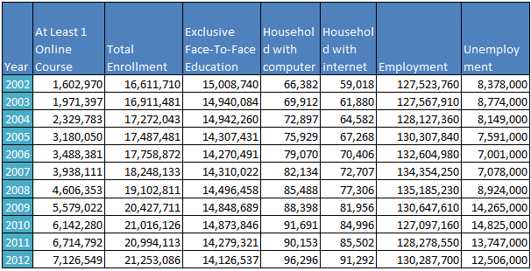
Findings (1)
Dataset to support our findings

Slide 25
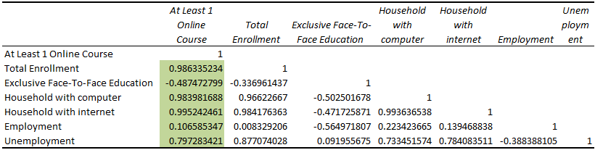
Findings (1) Cont.
Correlation between Online Education and other variables

Slide 26
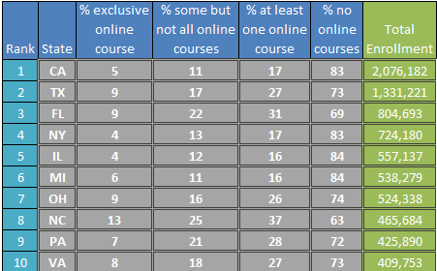
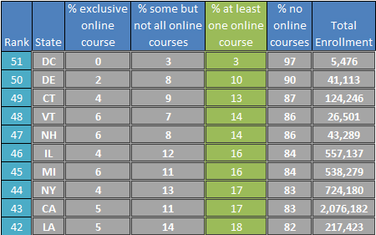
Findings (2)
Top 10 State for number of course enrollment in 2012
Bottom 10 State for % number of online course compared to non online course
= Same State

Slide 27
Findings (3)
3rd and 4th highest in 10 years
Reaching its peak on recession
What happens during recession?
Year | GDP Growth %
2002 | 3.3
2003 | 4.8
2004 | 6.6
2005 | 6.7
2006 | 5.8
2007 | 4.5
2008 | 1.7
2009 | -2.1
2010 | 3.7
2011 | 3.8
2012 | 4.6
F1 & F3 Visa Growth %
0
-7.9
1.5
8.7
15.1
9.0
14.3
-2.7
16.3
16.1
8.8
Employment Growth %
0.00
0.03
0.44
1.70
1.76
1.32
0.62
-3.36
-2.72
0.93
1.57
Unemployment Growth %
5.8
6.1
5.6
5.1
4.6
4.4
5.4
9.4
9.6
9
8.2
Total Enrollment Growth %
0.0
1.8
2.1
1.2
1.6
2.8
4.7
6.9
2.9
-0.1
1.2
Online Enrollment Growth %
0.0
23.0
18.2
36.5
9.7
12.9
16.9
21.1
10.1
9.3
6.1
Online Enrollment Increase
0
368,427
358,386
850,267
308,331
449,730
668,242
972,669
563,258
572,512
411,757

Slide 28
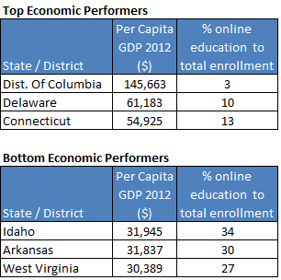
Findings (3) Cont.
Economic performance & Online Education

Slide 29
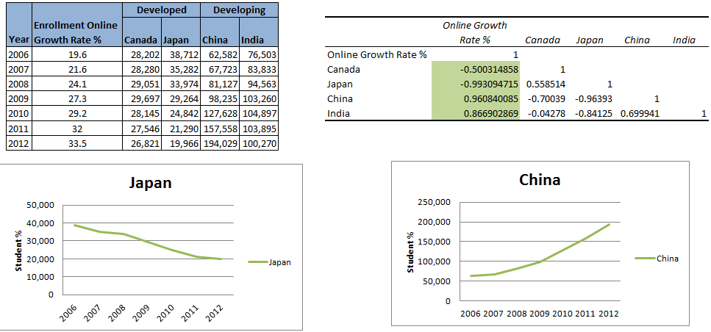
Findings (4)
International Students Enrollment

Slide 30
Findings (5)
Projection of online education in near future
continued …

Slide 31
Conclusion
Part VI

Slide 32
Conclusion
Traditional face-to-face Education
Online Education has an impact but it will not replace face-to-face education in the future.
Economic Development
Online Education and economic growth have a certain degree of relationship. Where there is less economic growth people are opting for online education as means for gaining education.
Enrollment Number of International Students
Online Education has impact on international students from developed countries like Canada, Japan, etc. As their total enrolment keeps on decreasing.

Slide 33
Conclusion Cont.
Employment/Unemployment Rate
Fall in employment is corresponding with increase in online education.
Increase of Internet Use at Home
Technology is the most significant factor that is contributing to online education. Not only household computers & internet connection but also mobiles & wireless connectivity are contributing to growth in Online Education.

Slide 34
Summary of Online Education (Take ins for the society)
Affordable → cheaper or even free
Accessible → convenient and can access it anytime
Access for rural & disabled student
Sustainable
On pace with the Future Education
Irrespective of age, background, etc.
People can get education while being employed.

Slide 35


Do you believe Online Education will replace Face-to Face Education?
What did the experts say?
I believe that MOOCs will not replace traditional campus-based learning. Instead, they may reach the newly forming markets of just-in-time learners, job-credentialing and skills-updating.
Those who can afford it will continue to pursue the traditional campus-based learning. Those who can't will choose among MOOC and other online-learning opportunities that are more affordable and flexible.
Already at my campus very nearly 45% of the credit hours are earned in online classes; more than one-third of the students did not come to campus, choosing instead to take only online courses.
Ray Schroeder University of Illinois
No, I Don’t
But far and away the most important effect of online education will be to bring in people who aren't part of the current educational system at all, from people with degrees and jobs using them for retraining (which we already see a lot of) to people who could never have afforded an M.S. in computer science now [being] able to get one from Georgia Tech for less than $7,000.
Clay Shirky
University of New York

Slide 36
Do you believe Online Education will replace Face-to Face Education?
What did we say?
We believe that Online Course will not replace face-to-face Education because there’s just some things you can’t get in online education, such as :
The school experience and class interaction
Since online course is cheap or even free, some student of online course didn’t finish the course, and they changed course a lot of time.
No certificates, or sometimes the online course certificates are not trusted.
However, we believe that Online Education will change the face of education and the number of educated people all around the world. There might be a lot of really smart people out there that can not continue their education because they don’t have money or they must work to make a living for their family. With Online Education they can continue their education while making their living which only costs the price of internet connection.
We believe this will help a lot of people and might even change the world.

Slide 37
Limitation
Part VII

Slide 38
Limitation
Since Online Education has a wide variety of scope, we limit our research for Online Education in US only and not globally.
Others variables that are not included are:
Data about the measurement of the quality of online education.
Cost Saving for online education courses compared to those traditional face-to-face education.
The success rate of online degree holders.

Slide 39
Options for Future Research
Part VII

Slide 40
Options for Future Research
Go Global - explore other countries in terms of Online Education and its impact.
Savings – figure out the saving in expenses for online education courses compared to traditional face-to-face education.
Environmental Impact – evaluate the reduction and savings in carbon emissions and environmental impact of online education system.
Success Rate – research how many online degree holders get hired and how employers prefer them over the traditional degree holders.

Slide 41
Relationship with SCI
Part VIII

Slide 42
Relationship with SCI
Creative Intelligence is holistic and it contains the wholeness of life.
Data generated contains the wholeness about the business and when we understand it and then analyze it, we will come up with interesting knowledge that will enrich and improve the business.

Slide 43
Quotes
Online Education is the single big change in the education since the printing press.
~ Anant Agarwal – President of edX ~
Five years from now (2010) on the web for free you’ll be able to find the best lectures in the world. It will be better than any single university.
~ Bill Gates – Chairman of Microsoft ~

Slide 44

Questions?

Slide 45


